Slide 1

Neonatal Assist
Jessica Chaya, Xiaoxia Jian, & Tobias Kahan, Presentation
Notes:
Toby
We are team Neonatal Assist.
Our Dev Team consists of Jessica Chaya, Xiaoxia Jian, and Tobias Kahan (me).

Slide 2

Link
Please visit us during the presentation.
neonatal-assist.herokuapp.com/
Notes:
Toby

Slide 3
PROJECT STATEMENT
PROBLEM
Nurses do not have fast access to current point-of-care support tools to assist in daily neonatal care.
SOLUTION
Create a visual and instructional mobile app that provides a collection of diagnostic and reference tools to assist nurses in neonatal care.
Notes:
Toby

Slide 4

System Architecture
Happy User
Android
iOS
Browser
Server
html
javascript
form-def.json
ODK Library
Excel
Excel
Notes:
Xiaoxia

Slide 5
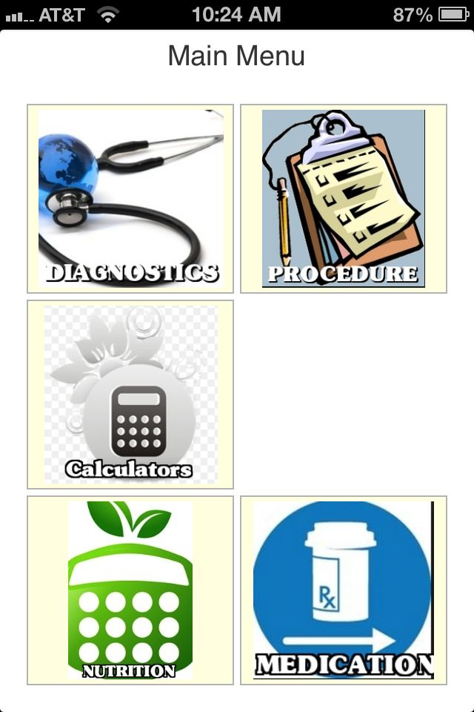
Notes:
Jessica

Slide 6
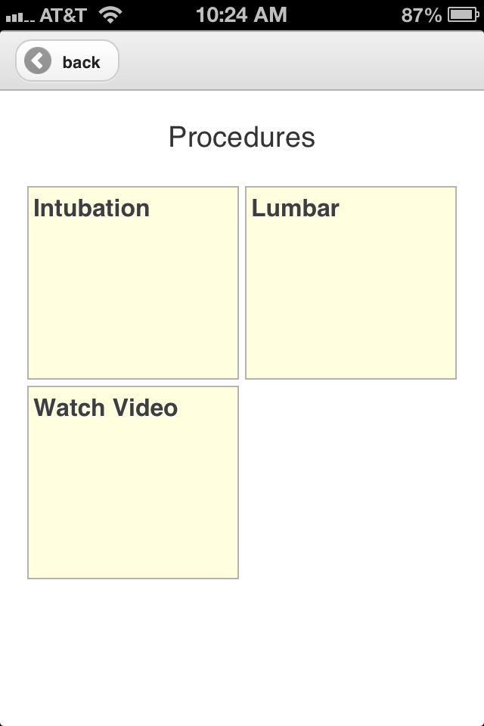
Notes:
Jessica

Slide 7
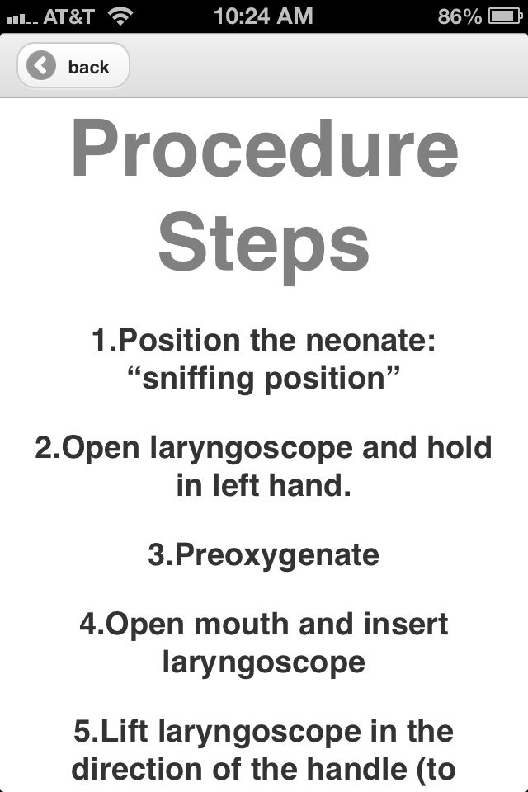
Notes:
Jessica

Slide 8
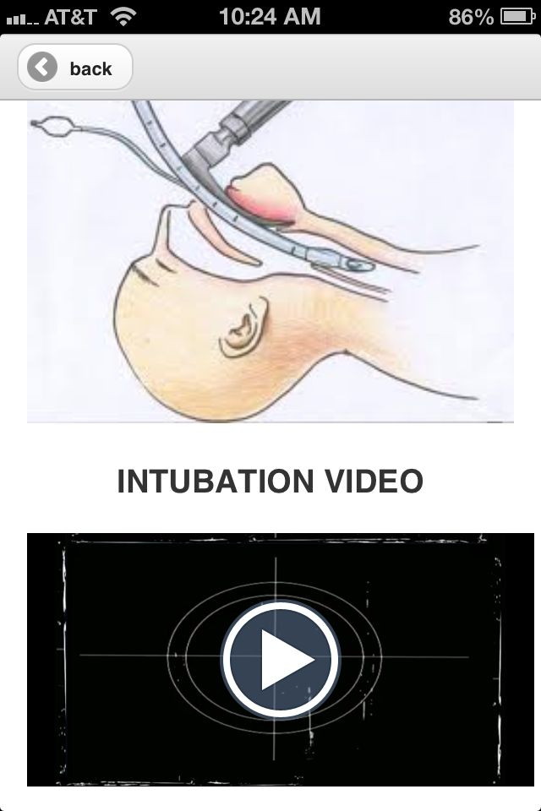
Notes:
Jessica

Slide 9
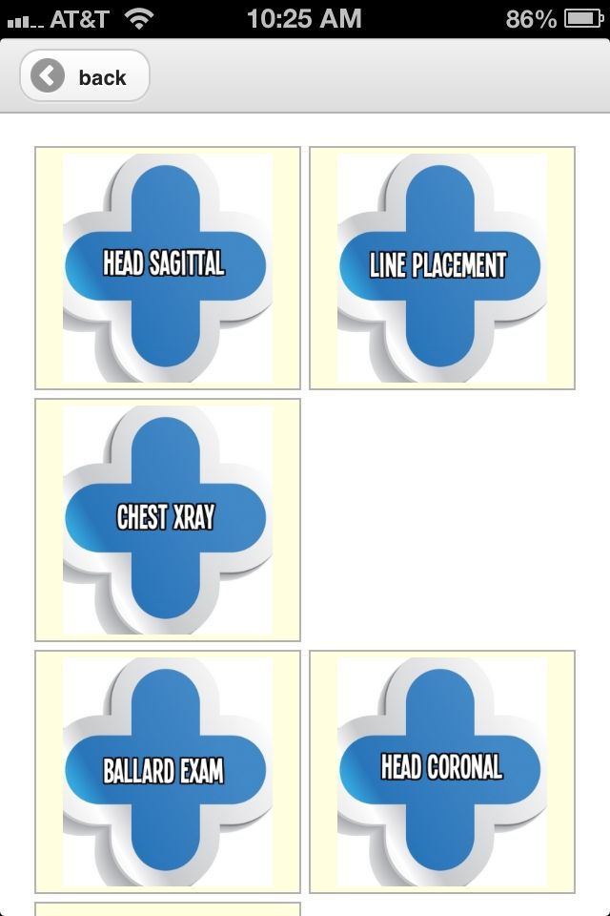
Notes:
Jessica

Slide 10
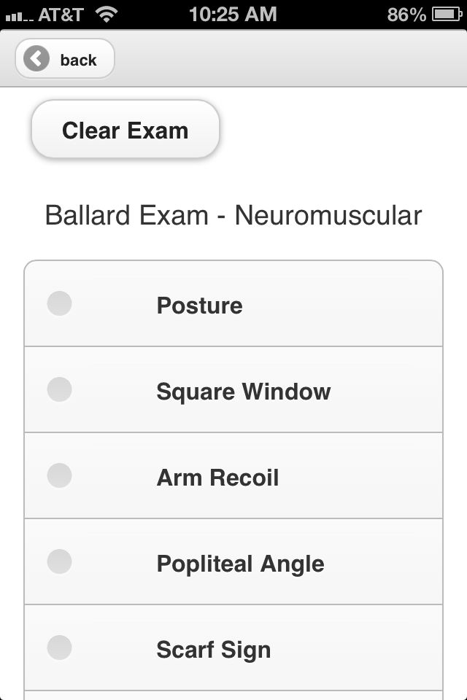
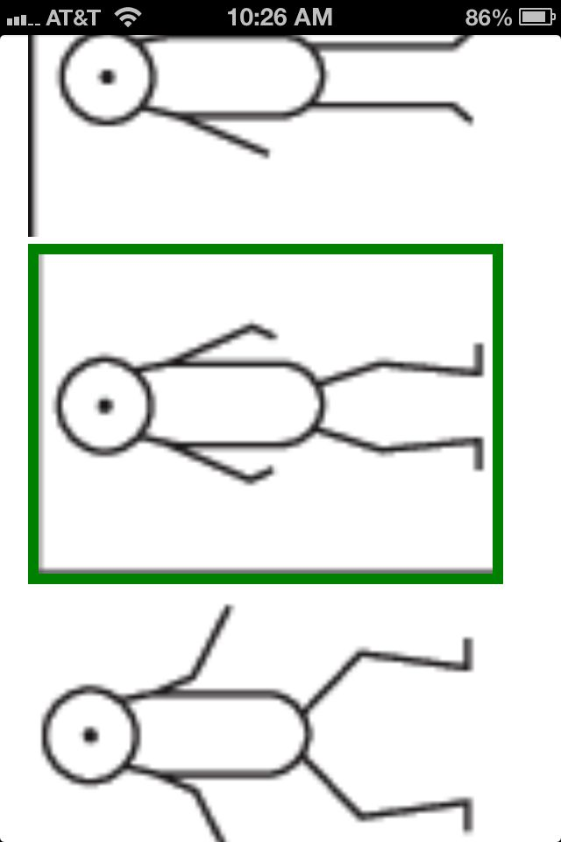
Notes:
Jessica

Slide 11
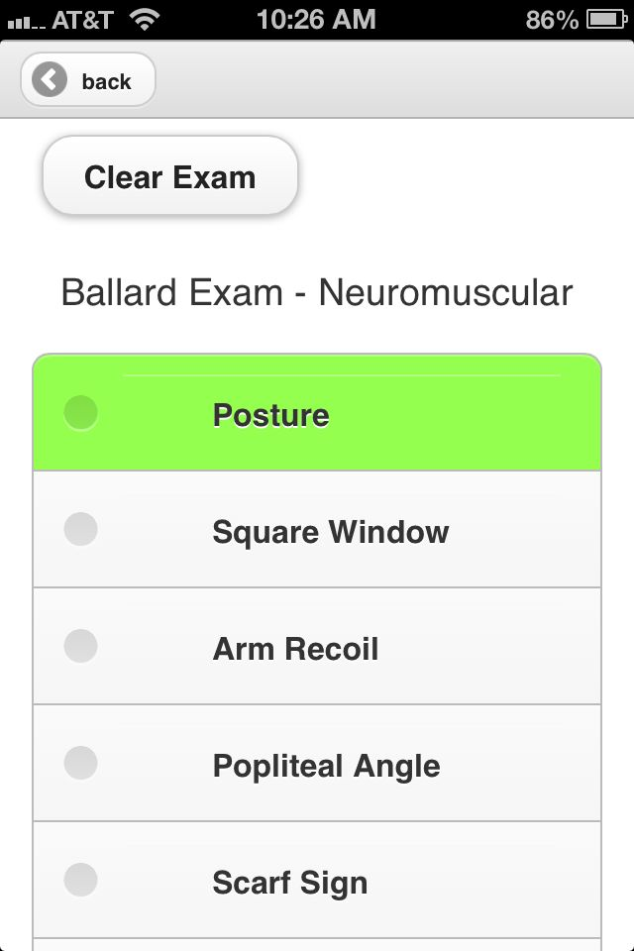
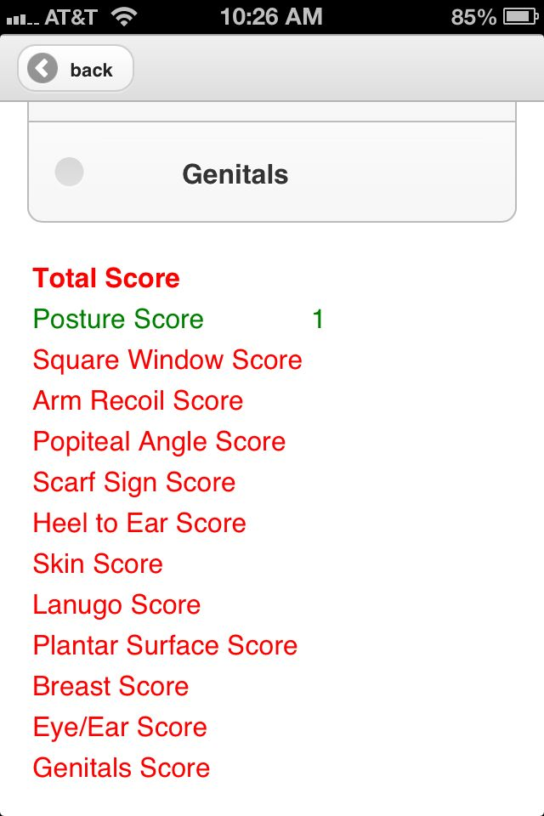
Notes:
Jessica

Slide 12
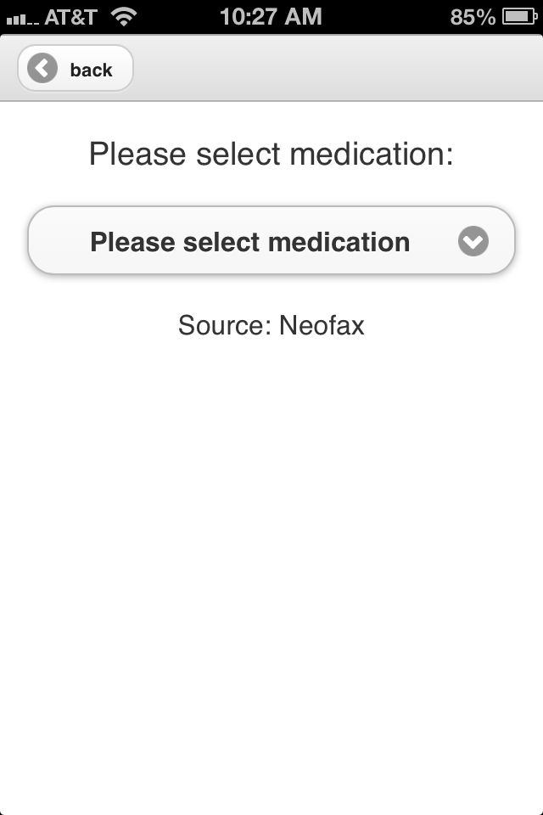
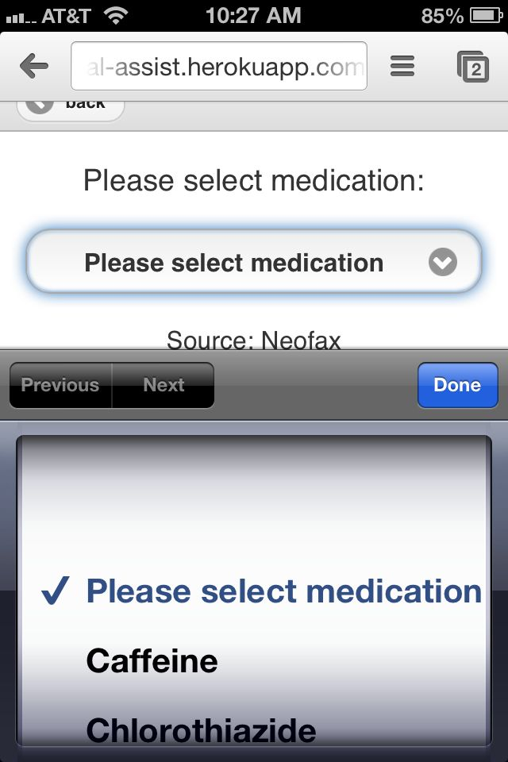
Notes:
Jessica

Slide 13
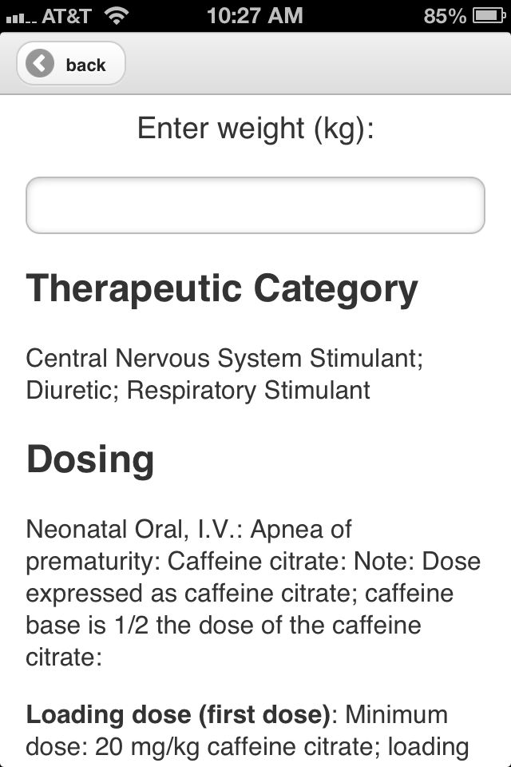
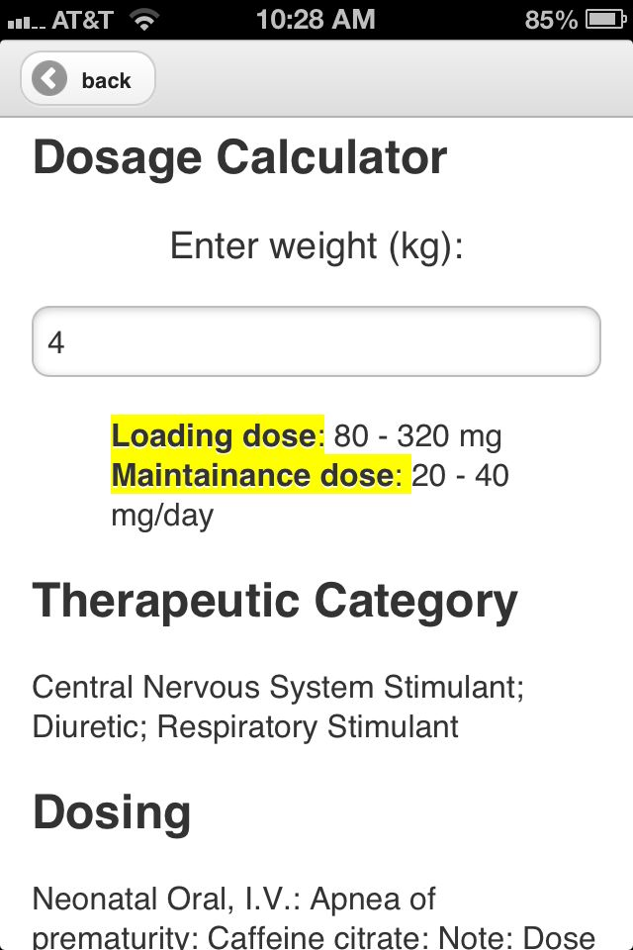
Notes:
Jessica

Slide 14
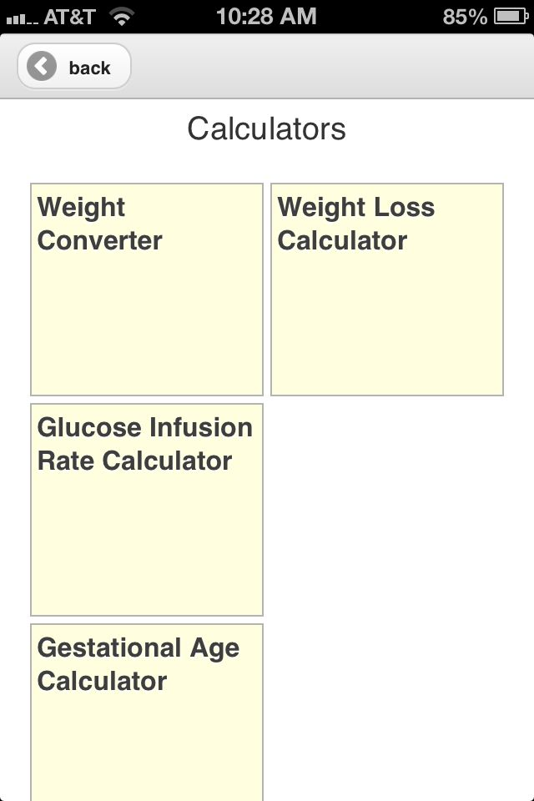
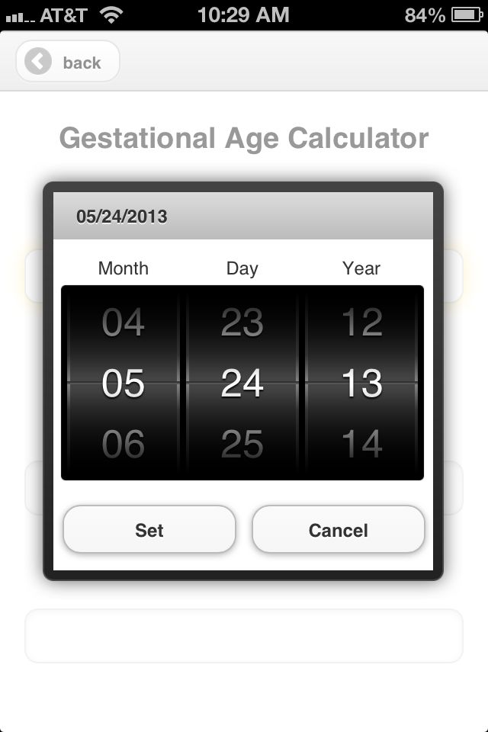
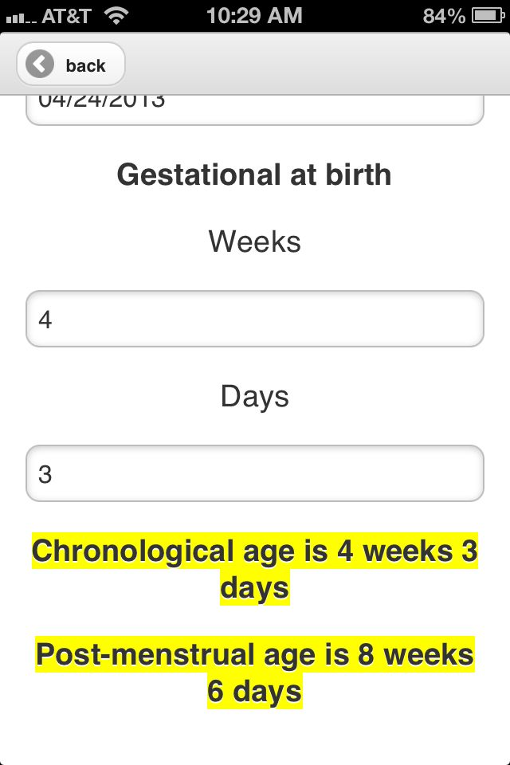
Notes:
Jessica

Slide 15
Challenges
Figure out the right workflow for our app.
Notes:
Jessica

Slide 16
Challenges
Design an efficient workflow for our app. Help from HCDE, Jocelyn, and usability testing with neonatal nurses.
Notes:
Jessica

Slide 17
Challenges
Integrating third party libraries with ODK. Modify ODK Builder.
Notes:
Jessica

Slide 18
Challenges
Version control of XLSX (No support for merging spreadsheets).
Side-by-side copy and paste.
Notes:
Jessica

Slide 19
Challenges
Tailor ODK Survey to the requirements of our app.
Contact experts in the field (Mitch).
Notes:
Jessica

Slide 20
Challenges
Notes:
Jessica

Slide 21
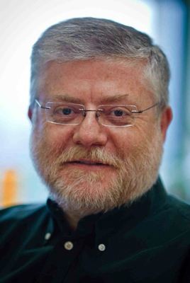

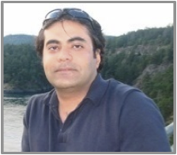
Self-Evaluation
How we will evaluate ourselves?
Functionality
Usability testing from nurses and feedback
Platform-compatibility
Notes:
Jessica

Slide 22

Questions?
?
Notes:
Development Team

